Slide 1
Variables with U.S. Congresswoman Ayanna Pressley (our district!!!)
September 28, 2019
Notes:
Photo: https://upload.wikimedia.org/wikipedia/commons/b/b9/Ayanna_Pressley_Portrait.jpg

Slide 2
Notes:
https://i.pinimg.com/originals/68/7e/76/687e76fdf22e5ad3f2daa07311a4737d.png

Slide 3
Jan 4, 2010 – Jan 3, 2019: Boston City Councilor

Slide 4
2019
Notes:
https://encrypted-tbn0.gstatic.com/images?q=tbn:ANd9GcSWQHV4hbWLTmQ5fdlbLvyW5Ltrm31Xrjc_2nzv176lKUsTCieZnA

Slide 5
Titles
2009
Title = “Boston City Councilor”
2019
Title = “U.S. Congresswoman”
Titles Over Time:
Title = [“Boston City Councilor”, ”U.S. Congresswoman”]
Notes:
Information: https://en.wikipedia.org/wiki/Ayanna_Pressley
Main Point: combinations of characters can be represented as a variable

Slide 6
Booleans (aka True or False)
Ayanna Pressley was born in Boston
Answer = ‘False’
Ayanna Pressley was the first woman of color
to serve on the Boston City Council
Answer = ‘True’
Ayanna Pressley is the first woman of color
to represent Massachusetts in Congress
Answer = ‘True’
Notes:
Information: https://en.wikipedia.org/wiki/Ayanna_Pressley
Main Point:

Slide 8
Votes
Democratic primary for U.S. House Massachusetts District 7
Votes = 60,046
General Election for U.S. House Massachusetts District 7
Votes = 216,559
% of Votes
percentVote = [58.6, 98.2]
Notes:
Data: https://en.wikipedia.org/wiki/Ayanna_Pressley
Main Point: numbers can be variables and it can be presented as integers (whole numbers) like for votes OR as float (decimal numbers) like percentage of votes. Plus, we can put them in a list.

Slide 9
"Since her first day in office, Ayanna has been unwavering and unapologetic in her advocacy on behalf of girls and women. She has been fighting to dismantle barriers to their development and advancement, and to address those issues that disproportionately and adversely impact them - issues often ignored in city halls and state houses across the nation."
Notes:
GWC: https://blogs.loc.gov/loc/files/2019/07/GWC.jpg

Slide 10
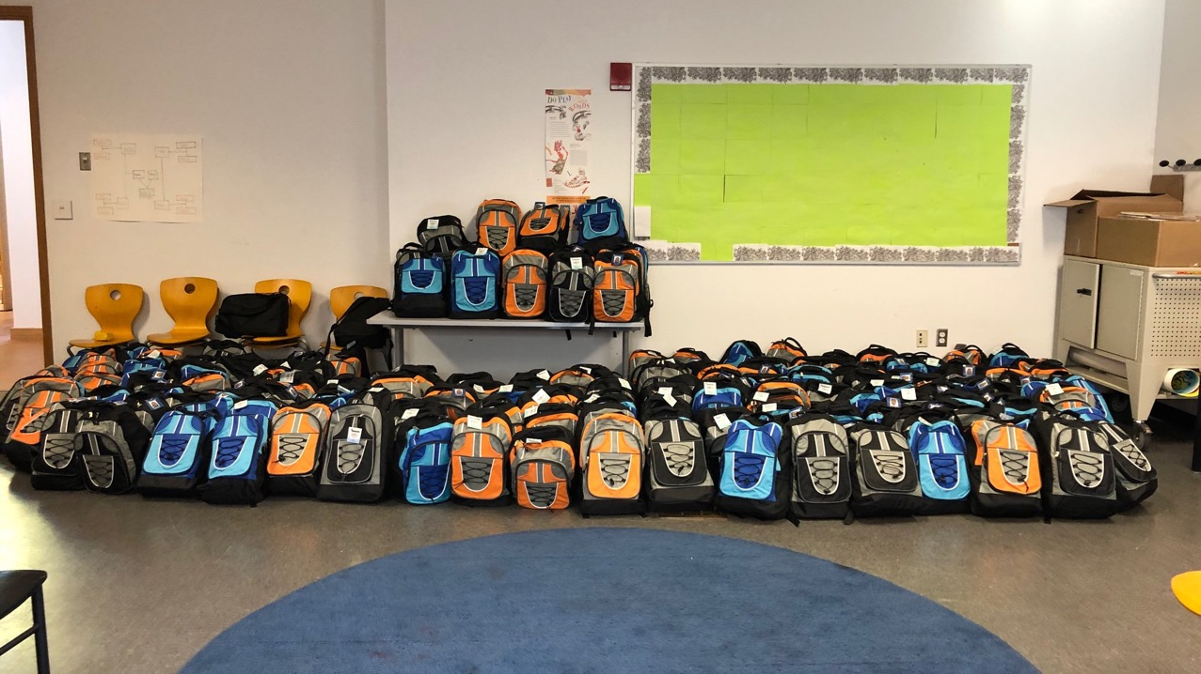
Community Code Day – October 12, 2019

Slide 11
We’re making invitations in Scratch! Go to: https://scratch.mit.edu/projects/332285422 See Inside!!

Slide 12
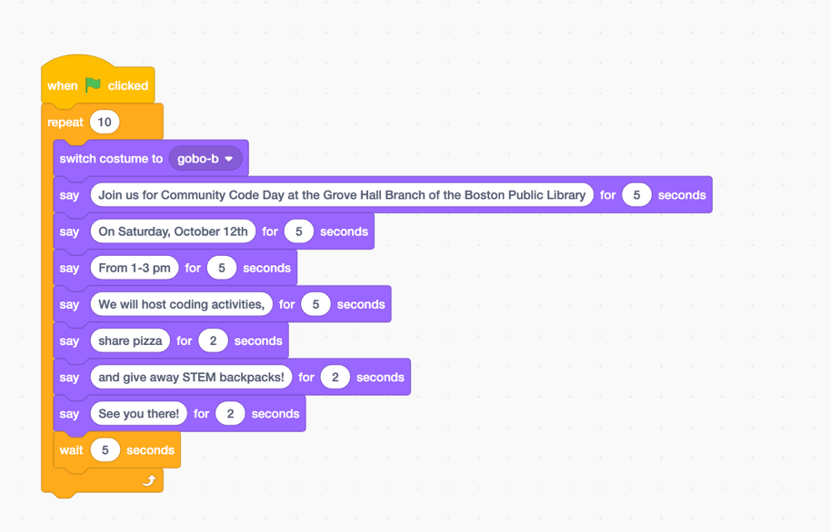
Events: User clicks flag and code starts
Control: Controls the code
Looks: Change the look of the characters (aka sprites)

Slide 13
Your Turn!
Customize the invitations
Change the Background or Sprite
Make them move!
Add sound
Code whatever you think will inspire folks to join us on Community Coding Day!

